Slide 1
Field to Database
Low Tech and High Tech Solutions

Slide 2
The problem at hand
How to accurately and completely transfer original data into content management system/database
Influenced by:
Field Data Recording Methods
Data Processing
Data Storage
Data Sharing

Slide 3
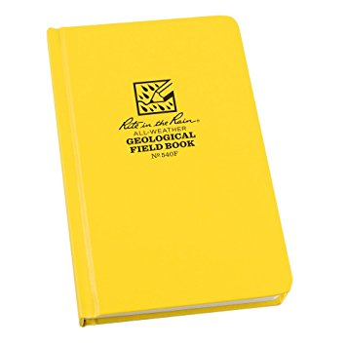
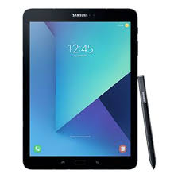
Field Data Recording Methods
This can vary greatly depending on what you are collecting/type of study

Slide 4

Data Processing
Transcription of field notes
Excel
Database web form
After the fact data
identifications
coordinates pulled from GPS file
additional descriptions
identifiers

Slide 5
Data Storage
Which CMS are you using?
Data Sharing
Where are you sharing the data?

Slide 6
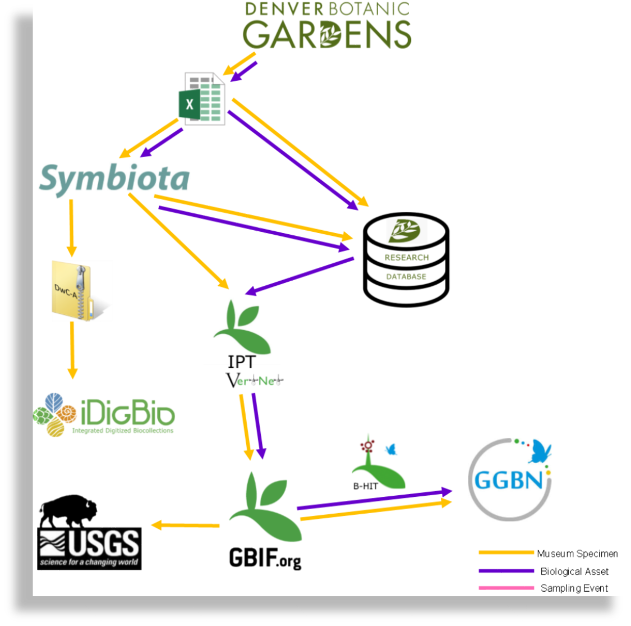
Its useful to make a data map

Slide 7
higher tech methods
iNaturalist
EpiCollect- form builder
Fulcrum- form builder
Diversity Workbench
CReAC (a KU lab-synced w/ Specify)
Denver Botanic Gardens Research Website

Slide 8
some super great stuff about iNaturalist
citizen science & super easy to use
projects & bioblitzes
community of identifiers and verifiers
images linked with records
georeferenced records
research grade data goes straight to GBIF!! (also gets picked up elsewhere)

Slide 9
where I have run into problems
The out of the box option is never good enough
using devices in the field is hard- especially when no internet
custom built applications are expensive- and then still, no one wants to use it
requires culture shift
only entering data once
if has to go to multiple places, go from database to database, rather than entering at multiple points

